Slide 1




THE EPIDEMIC OF INFLUENCE: UNDERSTANDING DRUG & NICOTINE DEPENDENCY
Presented by:
Farham Ahmad-BSDSF24A012
Muhammad Shahab-BSDSF24A032
Umar Shafiq-BSDSF24A050
Husnain Raza-BSDSF24A029

Slide 2

OVERVIEW:
In this presentation, we explore the growing issue of drug and nicotine use, especially among young people, by analyzing real-time data collected through a structured survey. The purpose of this study is to identify common patterns of exposure, perception, peer pressure, accessibility, and behavioral impact regarding substance use.
Using statistical tools such as Z-tests and T-tests, we tested several hypotheses related to students' exposure, peer influence, regulation opinions, and visibility of substance sales. The goal was to determine whether the observed trends in our data were significant enough to support broad claims.
The results of our analysis help shed light on:
The prevalence of nicotine and drug exposure in social environments
The influence of peer pressure and public perception
Early age of first exposure to substances
The effectiveness of regulations and awareness programs
The role of social surroundings and school environments

Slide 3
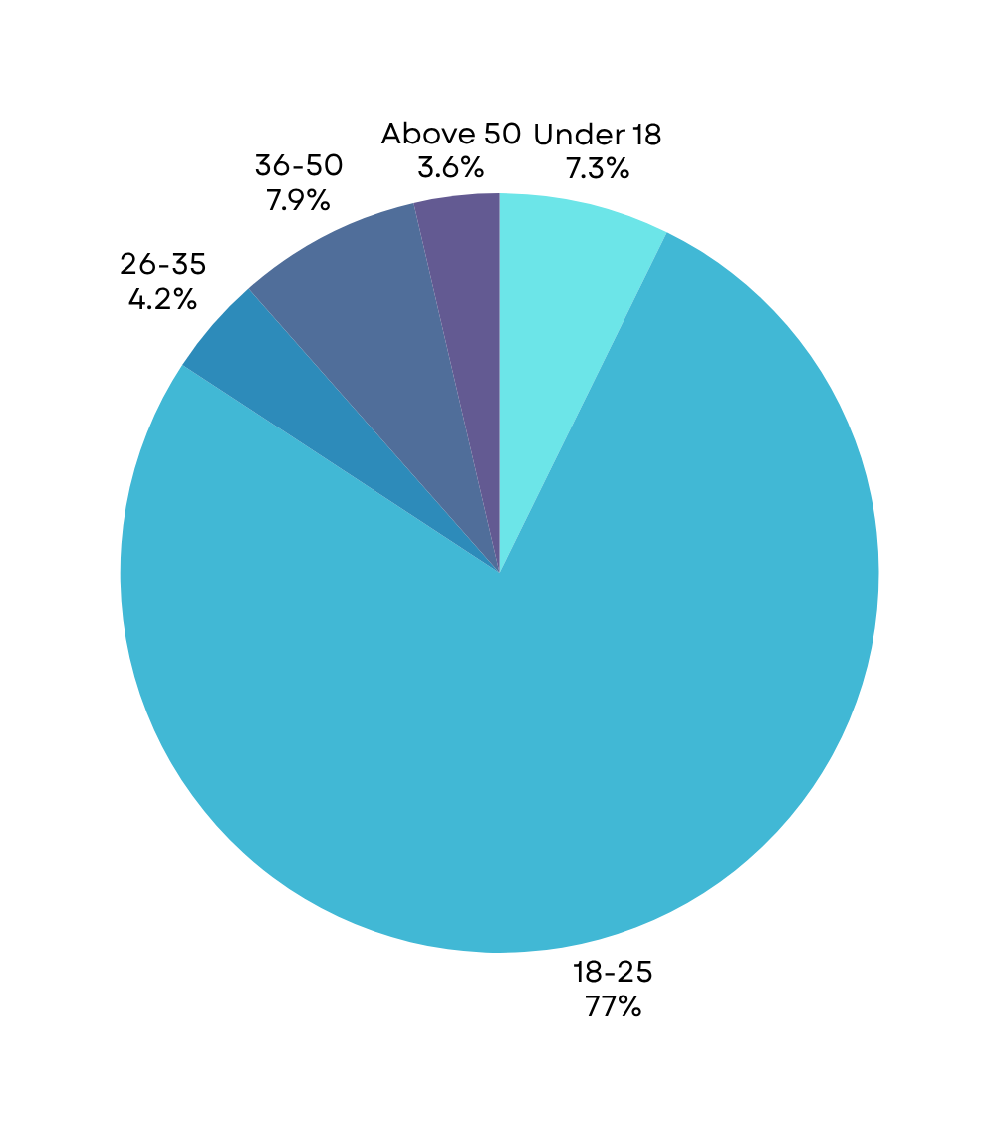

Age Group
Note:
With 77% of the participants falling within the 18–25 age bracket, the findings of this survey are largely reflective of young adult perspectives and behaviors.

Slide 4
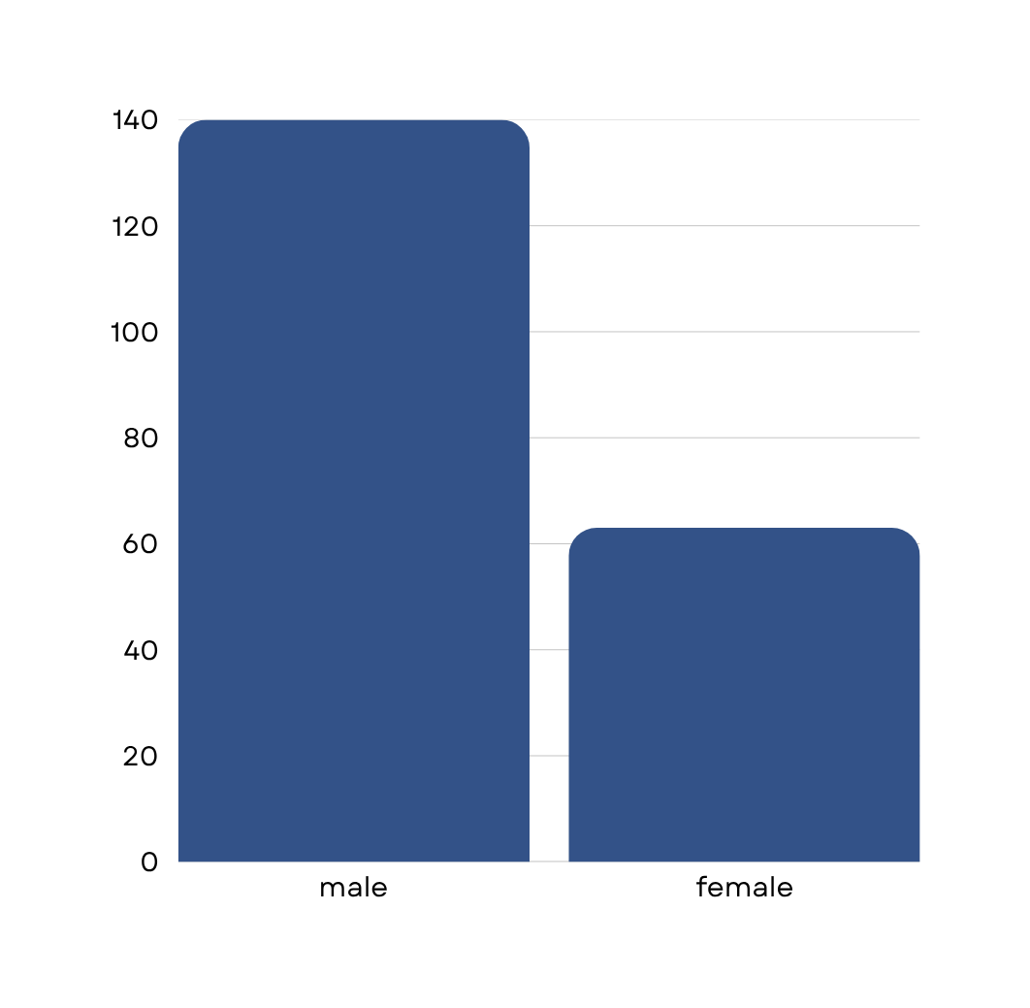
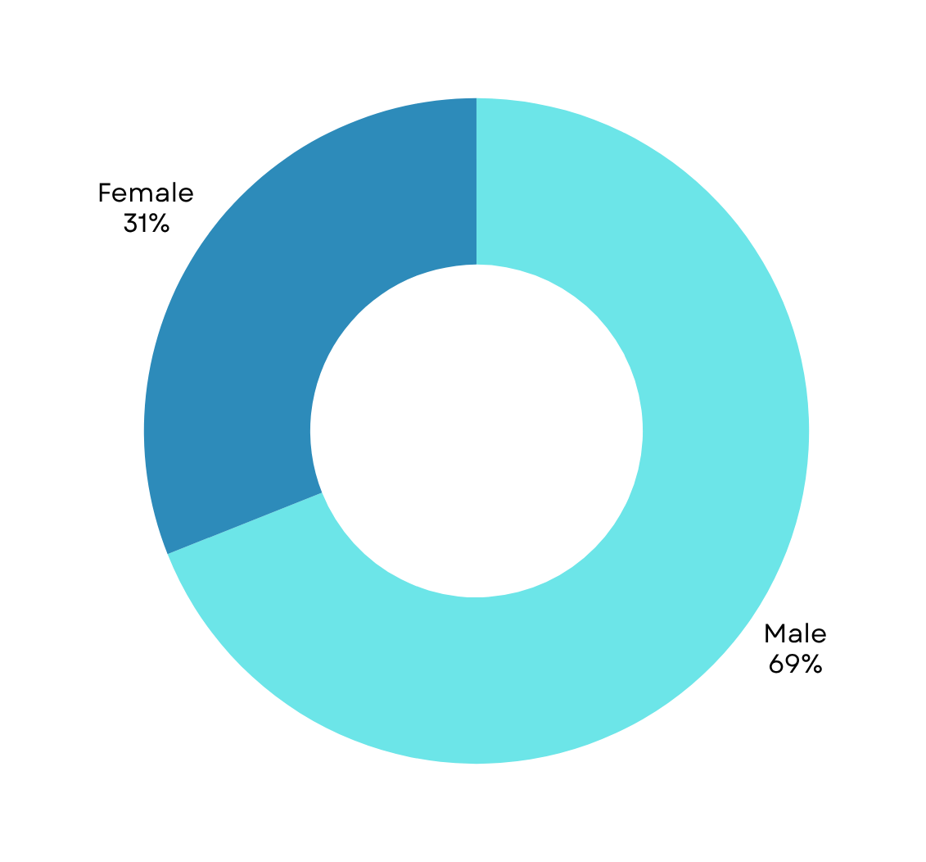


GENDER RESULTS
63
140

Slide 5
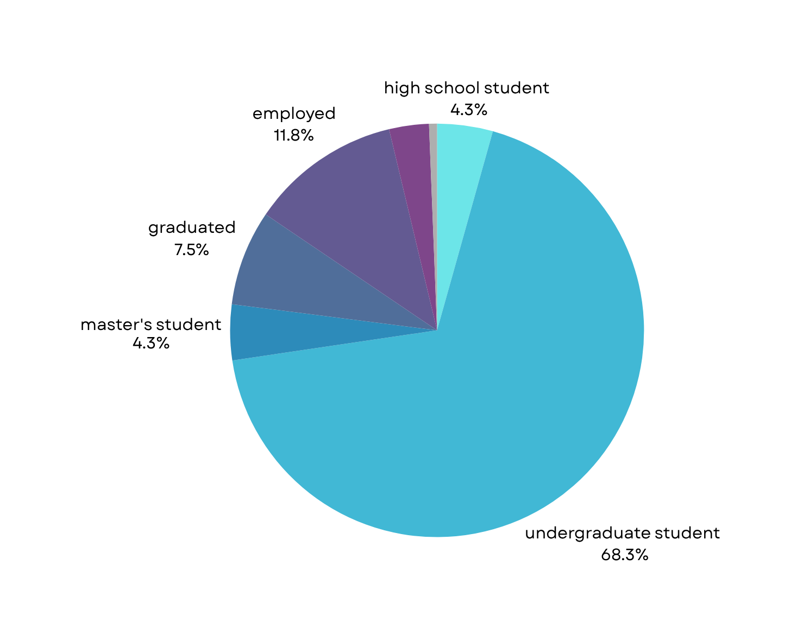
Current Status

Slide 6
Exposure to Drug/Nicotine Use
Exposure to Drugs
Sample size: 203
ANSWER | Frequency
yes, frequently | 60
yes, occasionally | 51
Rarely | 40
No, Never | 49
X = 60 + 51 + 40 = 151 (who are exposed )
n = 203 (size)
proportion : x/n
Conclusion:
The data shows that 77% of participants are exposed to drugs/nicotine use.

Slide 7
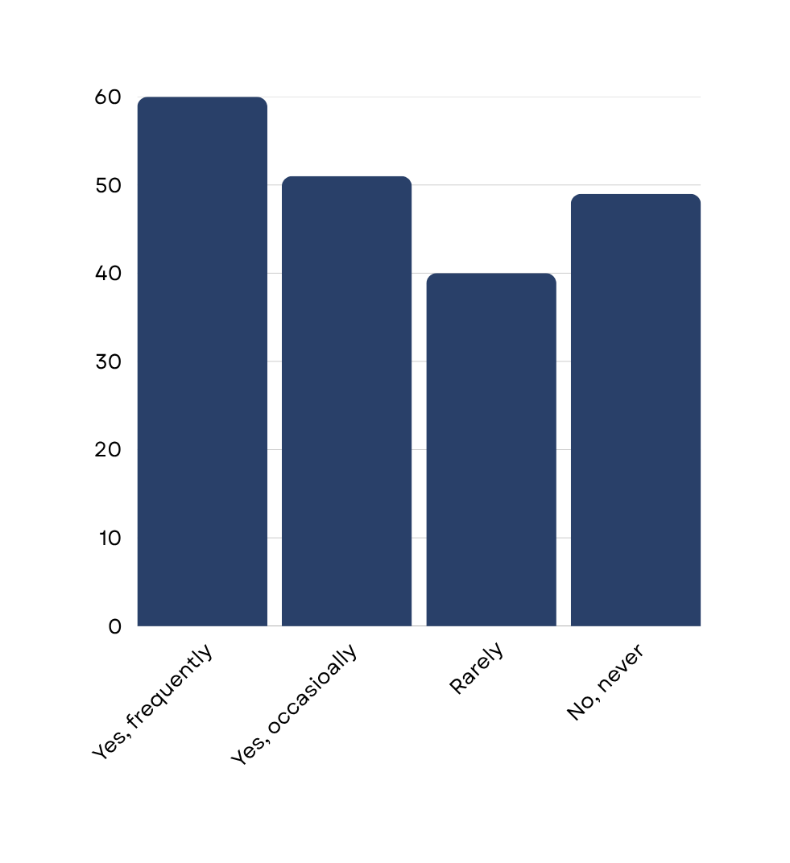


RESULTS
1
3

Slide 8
Hypothesis no: 01 Have you ever felt peer pressure to use nicotine or drugs?
Peer Pressure to use nicotine
or drugs
H₀: 50% of students did not felt peer pressure.
H₁: More than 50% of students did not felt peer pressure.
Calculation:
H₀: p = 0.5
H₁: p > 0.5
Z = 5.56
Zₐ = 1.645
Z > Zₐ
CI = 0.630 < p < 0.759
Conclusion:
We reject the null hypothesis because the calculated Z-value is greater than the critical Z-value.
This indicates that more than 50% of students did not feel peer pressure to use nicotine or drugs.
ANSWER | Frequency
yes, often | 23
yes, occasionally | 39
no, never | 141

Slide 9
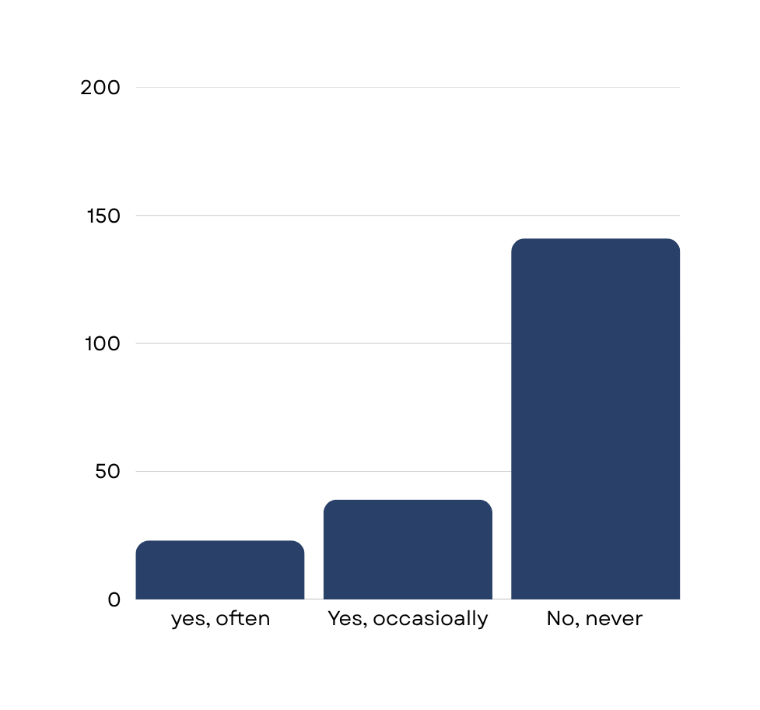
RESULTS:
RESULTS:
1
3

Slide 10
Peer Pressure to use drugs/nictoine
Sample size: 203
X = 23+39 = 62 (who felt pressure )
n = 203 (size)
proportion : x/n
Conclusion:
Approximately 30.5% of the respondents reported experiencing peer pressure to use drugs or nicotine products.

Slide 11
Hypothesis no: 02 Nicotine Among Youth
Response | Frequency | Score
very common | 75 | 5
somewhat common | 60 | 4
neutral | 26 | 3
Rare | 24 | 2
Not at all | 18 | 1

Slide 12
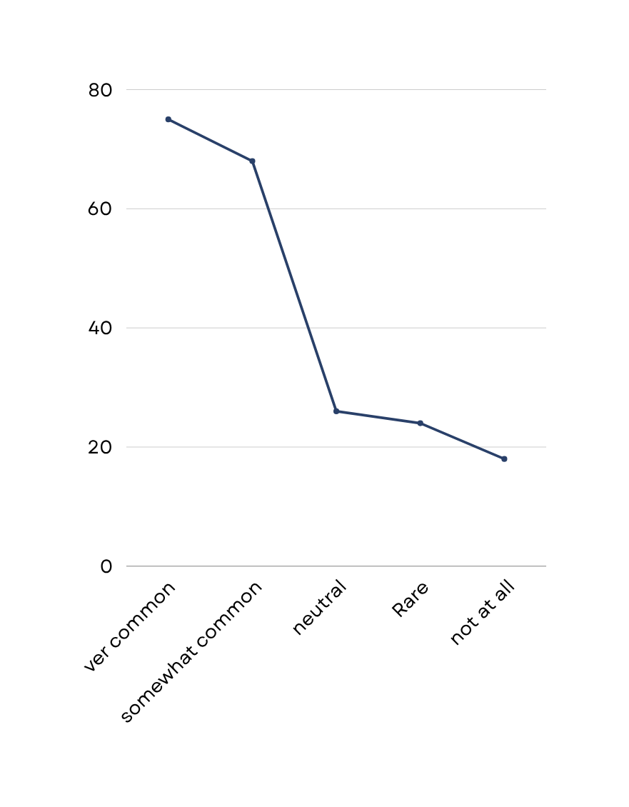
Null and Alternative Hypothesis:
H₀: μ = 3 (Neutral opinion)
H₁: μ > 3 (Vape use is perceived as common)
Calculation:
Sample Mean (x̄) = 3.73
Sample Standard Deviation (s) = 1.31
Sample Size (n) = 203
t = 7.94
tₐ = 1.652
t > tₐ
CI = 3.55 < μ < 3.91
Conclusion:
We reject the null hypothesis because the calculated t-value is greater than the critical t-value.
This indicates that vape use is perceived as significantly more common than neutral among young people in the sample.

Slide 13


Hypothesis no 03: Regulation Support
H₀: 60% support regulation
H₁: More than 60% support regulation
Calculation:
H₀: p = 0.6
H₁: p > 0.6
Total responses = 203
Support regulation = 105 (complete ban) + 68 (harder access for young people) = 173
Sample proportion (p̂) = 173 / 203 ≈ 0.8522
Standard error = √[p(1 - p) / n] = √[0.6 * 0.4 / 203] ≈ √[0.24 / 203] ≈ √0.001183 ≈ 0.0344
Z = (p̂ - p) / Standard error = (0.8522 - 0.6) / 0.0344 ≈ 0.2522 / 0.0344 ≈ 7.33
Zₐ = 1.645 (for α = 0.05, one-tailed test)
Z > Zₐ
CI = p̂ ± Zₐ * Standard error = 0.8522 ± 1.645 * 0.0344
= 0.8522 ± 0.0566
= 0.7956 < p < 0.9088

Slide 14
Conclusion:
We reject the null hypothesis because the calculated Z-value (7.28) is greater than the critical Z-value (1.645).
This indicates that more than 60% of respondents support stricter regulation of nicotine/vape products.

Slide 15
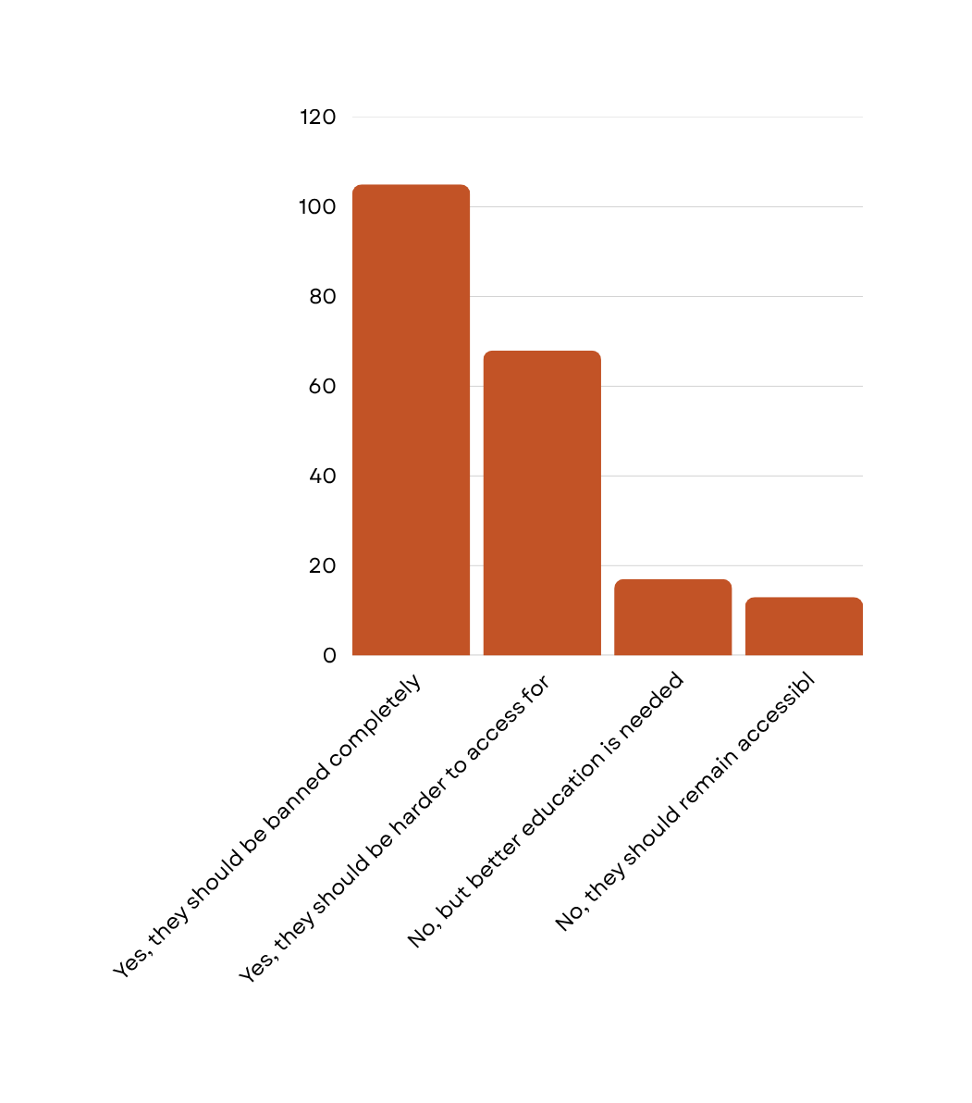
Graphical representation:

Slide 16

SELLING OF NICOTINE /DRUGS IN YOUR SCHOOL/COMMUNITY
This breakdown indicates that nearly 56.45%(115/203) have some exposure to sales (frequent or occasional), with a slight majority never witnessing it (43.55%). This could suggest a need for targeted interventions in schools or online platforms, though no formal statistical test is applied here beyond descriptive statistics.
Yes, frequently: 56 / 203 ≈ 27.59%
Yes, occasionally: 59 / 203 ≈ 29.06%
No, never: 88 / 203 ≈ 43.35%

Slide 17
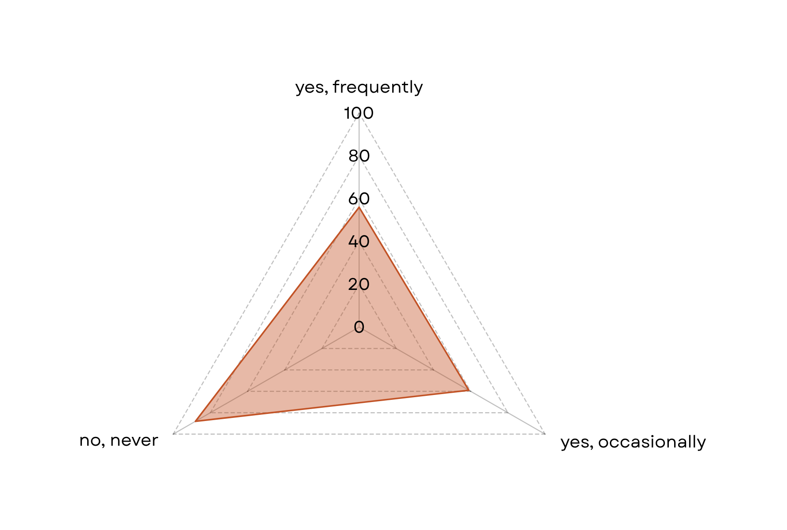

Slide 18
Hypothesis no 04: Nicotine product usage
H₀: 40% or fewer have tried nicotine products
H₁: More than 40% have tried nicotine products
Calculation:
H₀: p = 0.4
H₁: p > 0.4
Total responses = 25 + 27 + 45 + 106 = 203
Tried nicotine products = 25 (yes regularly) + 27 (yes occasionally) + 45 (tried once or twice) = 97
Sample proportion (p̂) = 97 / 203 ≈ 0.4778
Standard error = √[p(1 - p) / n] = √[0.4 * 0.6 / 203] ≈ √[0.24 / 203] ≈ √0.001183 ≈ 0.0344
Z = (p̂ - p) / Standard error = (0.4778 - 0.4) / 0.0344 ≈ 0.0778 / 0.0344 ≈ 2.26
Zₐ = 1.645 (for α = 0.05, one-tailed test)
Z > Zₐ
CI = p̂ ± Zₐ * Standard error = 0.4778 ± 1.645 * 0.0344
= 0.4778 ± 0.0566
= 0.4212 < p < 0.5344

Slide 19
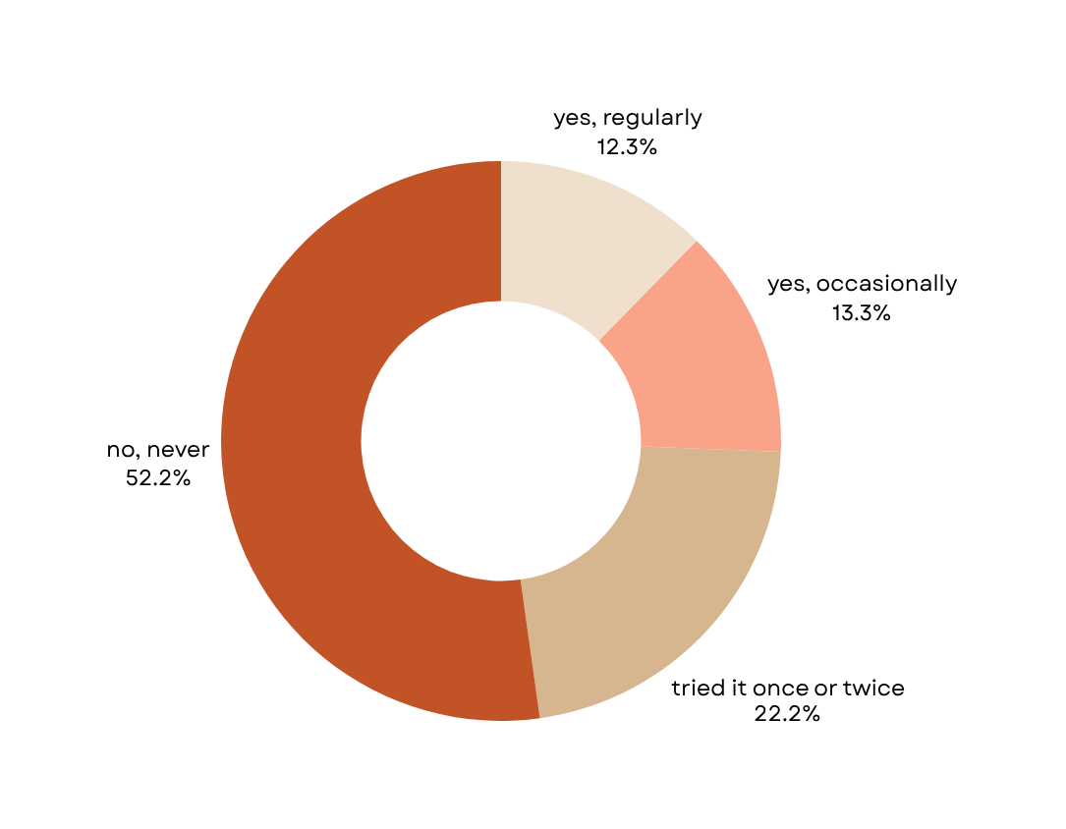
Conclusion:
We reject the null hypothesis because the calculated Z-value (2.26) is greater than the critical Z-value (1.645).
This indicates that more than 40% of respondents have tried nicotine products (cigarettes, pods, vapes, etc.).

Slide 20
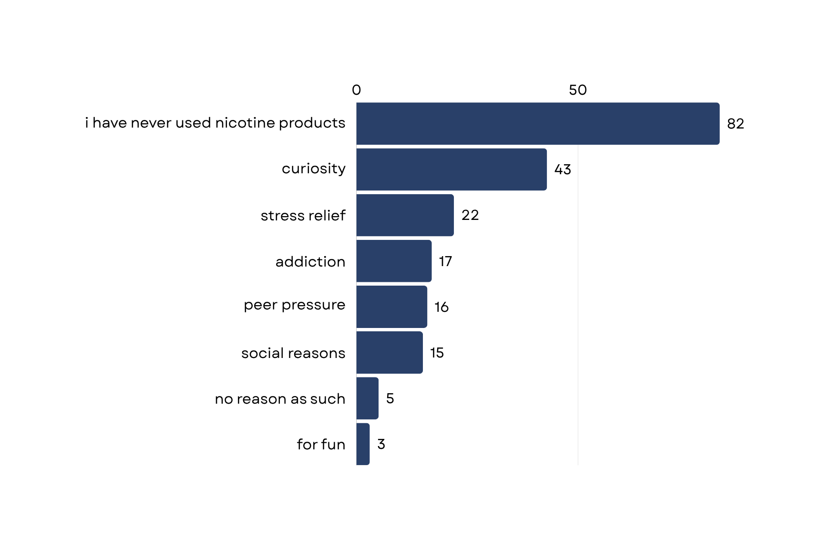

Main reason for trying nicotine products?

Slide 21
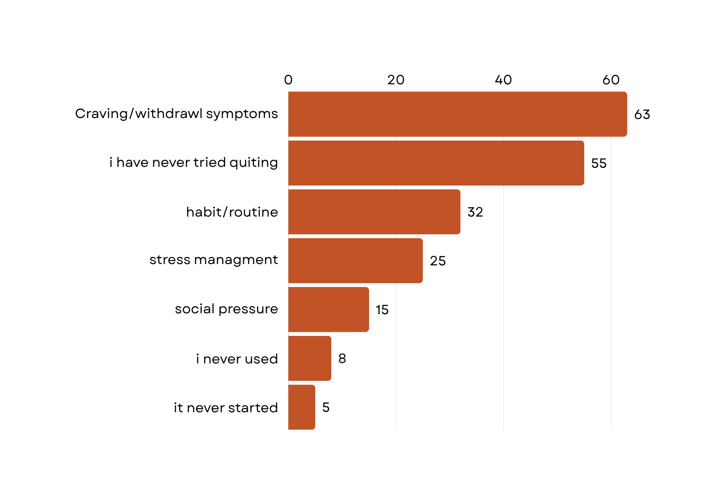

Distribution of Reported Challenges in Quitting Nicotine or Drug Use Among Respondents

Slide 22

Conclusion:
The statistical evidence strongly indicates a significant public concern regarding nicotine and drug use among the surveyed population. With over 85% supporting regulation, 56% observing sales, and 47% having personal experience with nicotine, there is a clear need for intervention to address accessibility, education, and support.
Recommendations:
Strict Regulations
Educational Campaigns
Support Systems
Monitoring and Enforcement

Slide 23

“Thank you for time”
and
always
“Say no to drugs”

